Slide 1
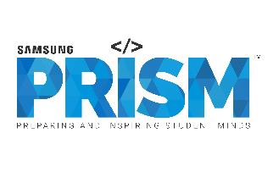
Samsung PRISM: Monthly Connect - 2
Date: 27th February 2024
Worklet 1: Build an LLM Backed Prompt Generator [NLP Queries > Efficient Prompts]
Team
College Professor(s):
Dr. Lydia Jane G | lydiajane.g@vit.ac.in
Dr. Tamizharasi T | tamizharasi.t@vit.ac.in
Students:
Agrim Patil | agrim.patil2021@vitstudent.ac.in
Shreya Gupta | shreya.gupta2021a@vitstudent.ac.in
Debosmita Chatterjee | debosmita.chatterjee2021@vitstudent.ac.in
Department: SCOPE: School of Computer Science and Engineering

Slide 2
Work-let Name: Build an LLM Backed Prompt Generator [NLP Queries > Efficient Prompts]
Worklet Details
Worklet ID: 23RSG23
Agrim Patil, Debosmita, Shreya
College Name: Vellore Institute of Technology
Analysed an adaptive framework to optimize prompts for text-to-image generation.
Assessed a fully self-referential self-improving prompt breeder backed by a LLM.
Reviewed and tried implementing the open-source model “Mistral 7B” as the source LLM
KPIs achieved till now
Any Challenges/ Issues faced
Complexity of handling a open-source model on “HuggingFace” platform
Integrating the model may require some customization.
If we want to train the model, it would be computationally expensive and alternative options like Google Colab must be explored.
Next Steps:
Upload the “Mixtral-7B-v0.1” model on google drive and use via collab.
In-Depth analysis of various enhancement frameworks and techniques.
Key Achievements/ Outcome till now
Set parameters to gauge how efficient a prompt is using the “neuro-prompt framework”
“PromptBreeder” analysis
Reviewed the “Mixtral-7B-v0.1” model on huggingface.com
Date: 27th February

Slide 3
NEURO-PROMPTS: An adaptive framework to Optimize Prompts for Text To Image Generation
OVERVIEW:
Introduction
- Text-to-image generation has gained popularity with advances in latent diffusion models.
- Prompt engineering expertise is crucial for improving image quality.
- NeuroPrompts is introduced as an adaptive framework for enhancing user prompts automatically.
NeuroPrompts Framework
- Two-stage approach: adapting a language model and generating enhanced prompts.
- Constrained text decoding with NeuroLogic for user control and improved image quality.
- Significance: user customizability, improved image quality, and coverage of image enhancement keywords.
Comparison with Human-Engineered Prompts
- NeuroPrompts outperforms human-engineered prompts in image quality.
- Higher aesthetics score and PickScore for images generated using optimized prompts.
- Demonstrates the framework's effectiveness in producing aesthetically pleasing images.
Applications and Benefits
- NeuroPrompts unlocks the full potential of text-to-image diffusion models for users.
- Increases accessibility and automation in deploying text-to-image models.
- Potential extensions to video generation models and other settings benefiting from prompt engineering.
Limitations and Future Work
- Compatibility with any text-to-image generation model.
- Evaluation limited to Stable Diffusion due to computational resources.
- Future work includes expanding NeuroPrompts to video generation models and exploring automated prompt engineering in various settings.
Conclusion
- NeuroPrompts is a novel framework for optimizing prompts in text-to-image generation.
- Provides user control, improves image quality, and automates prompt engineering.
- Demonstrates superior image quality compared to human-engineered prompts.

Slide 4
NeuroPrompts
An Adaptive Framework to Optimize Prompts for Text-to-Image Generation! It is a framework that automatically enhances user prompts to improve the quality of images generated by text-to-image models. The framework utilizes constrained text decoding with a pre-trained language model to mimic human prompt engineers, resulting in higher-quality image generations.
How does NeuroPrompts enhance user prompts for text-to-image generation?
NeuroPrompts enhances user prompts for text-to-image generation through a two-stage approach:
1. Adapting a Language Model (LM): The framework first adapts a language model to generate text that aligns with the style of prompts typically created by human prompt engineers. This step aims to steer the generated text towards a style that is more likely to result in aesthetically pleasing images when used as a prompt.
2. Generating Enhanced Prompts: Using a constrained text decoding algorithm called NeuroLogic, NeuroPrompts generates enhanced prompts based on the text produced by the adapted language model. This constrained text decoding approach allows for user customizability and improves the coverage of keywords related to image enhancement.
By following this two-stage process, NeuroPrompts aims to automatically optimize user prompts to increase the likelihood of producing aesthetically pleasing images when fed into text-to-image diffusion models.

Slide 5
What is the significance of utilizing constrained text decoding with a pre-trained language model in this framework?
The significance of utilizing constrained text decoding with a pre-trained language model in the NeuroPrompts framework lies in its ability to enhance user prompts for text-to-image generation in the following ways:
1. User Control and Customizability: Constrained text decoding with NeuroLogic allows users to have control over the prompt optimization process. Users can specify constraints related to style, format, artist, booster, perspective, vibe, and negative phrases, enabling them to tailor the generated prompts to their specific preferences and requirements.
2. Improved Image Quality: By leveraging a pre-trained language model that has been adapted to generate prompts similar to those created by human prompt engineers, the framework can produce enhanced prompts that are more likely to result in higher-quality image generations. This adaptation ensures that the generated prompts align with established stylistic conventions that are known to produce aesthetically pleasing images.
3. Coverage of Image Enhancement Keywords: The constrained text decoding process with NeuroLogic enhances the coverage of prompt enhancement keywords in the generated prompts. This can lead to more comprehensive and effective prompts that guide text-to-image models towards producing desired and visually appealing images.
Overall, the utilization of constrained text decoding with a pre-trained language model in the NeuroPrompts framework enhances user prompts by providing control, improving image quality, and ensuring the inclusion of relevant image enhancement keywords, thereby optimizing the text-to-image generation process.

Slide 6
How does NeuroPrompts compare to human-engineered prompts in terms of image quality in text-to-image generation experiments?
NeuroPrompts demonstrates its effectiveness by automatically optimizing user prompts for text-to-image generation, achieving image quality comparable to or even surpassing that of human-engineered prompts. Here are some key points regarding the comparison between NeuroPrompts and human-engineered prompts in text-to-image generation experiments:
1. Higher Aesthetics Score: NeuroPrompts has been shown to significantly improve the aesthetics of generated images compared to un-optimized baseline prompts. The optimized prompts produced by NeuroPrompts even outperform those created by human prompt engineers, indicating the framework's ability to unlock the full potential of text-to-image generation models for users without expertise in prompt engineering.
2. Improved PickScore: NeuroPrompts consistently achieves a higher PickScore for generated images compared to prompt prefixes. The average PickScore for images generated using optimized prompts is 60%, representing a 20% absolute improvement in the predicted likelihood of human preference for the optimized images relative to those produced by prompt prefixes.
3. Consistent Higher-Quality Images: Experimental results demonstrate that NeuroPrompts consistently produces higher-quality images, indicating that the framework can be a practical tool for artists, designers, and creative professionals to generate personalized and high-quality images without the need for specialized prompt engineering expertise.
In summary, NeuroPrompts not only matches the image quality achieved by human prompt engineers but also surpasses it in certain aspects, showcasing its effectiveness in automatically optimizing prompts for text-to-image generation and producing aesthetically pleasing images.

Slide 7
ADVANTAGES OF NEUROPROMPTS
One of the key advantages of NeuroPrompts lies in its ability to automatically optimize user prompts for text-to-image generation, offering several benefits:
1. Enhanced Image Quality: By adapting a language model and utilizing constrained text decoding, NeuroPrompts can significantly improve the aesthetics and overall quality of generated images. The framework's optimization process ensures that the prompts provided to text-to-image models are tailored to produce visually appealing results, leading to higher-quality outputs.
2. User Control and Customizability: NeuroPrompts allows users to specify constraints related to style, format, and other attributes, giving them control over the prompt optimization process. This level of customization enables users to tailor the generated prompts to their specific preferences and requirements, resulting in more personalized and diverse image generations.
3. Automation and Accessibility: NeuroPrompts automates the prompt optimization process, eliminating the need for users to have specialized prompt engineering expertise. This automation makes text-to-image generation more accessible to a wider range of users, including artists, designers, and creative professionals who may not have prior experience in prompt engineering.
4. Efficiency and Effectiveness: The framework's two-stage approach, coupled with the use of a pre-trained language model and constrained text decoding, ensures that the generated prompts are optimized for image enhancement keywords and stylistic conventions. This optimization process enhances the efficiency and effectiveness of text-to-image generation, leading to improved results in terms of image quality and aesthetics.
Overall, NeuroPrompts offers a powerful solution for optimizing prompts in text-to-image generation, providing users with the tools and capabilities to generate high-quality, personalized images with ease and efficiency.

Slide 8
DRAWBACKS OF NEUROPROMPTS
While NeuroPrompts offers several advantages in optimizing prompts for text-to-image generation, there are also some potential drawbacks to consider:
1. Limited Model Compatibility: NeuroPrompts may be designed to be broadly compatible with various text-to-image generation models, but the evaluation in the provided study was limited to Stable Diffusion due to computational constraints. This limitation may restrict the applicability of NeuroPrompts to a specific subset of models, potentially limiting its versatility.
2. Computational Resources: The optimization process in NeuroPrompts, which involves adapting a language model and utilizing constrained text decoding, may require significant computational resources. This could pose challenges for users with limited access to high-performance computing resources, potentially hindering the widespread adoption of the framework.
3. Complexity for Novice Users: While NeuroPrompts aims to automate prompt optimization and make text-to-image generation more accessible, the framework's advanced features and customization options may be overwhelming for novice users. Users without prior experience in prompt engineering or text-to-image generation may find the framework complex and challenging to navigate.
4. Evaluation Scope: The evaluation of NeuroPrompts in the provided study focused primarily on image quality and aesthetics. While these are important metrics, the framework's performance in other aspects, such as scalability, real-time processing, or compatibility with different types of prompts, may require further evaluation to assess its overall effectiveness and practicality.
5. Dependency on Pre-trained Models: NeuroPrompts relies on pre-trained language models and constrained text decoding algorithms for prompt optimization. Any limitations or biases present in these pre-trained models could potentially impact the quality and effectiveness of the generated prompts, highlighting the importance of continuous model updates and improvements.
Overall, while NeuroPrompts offers significant advantages in enhancing prompt optimization for text-to-image generation, addressing these potential drawbacks through further research, optimization, and user-friendly interfaces could enhance the framework's usability and effectiveness in a wider range of applications.

Slide 9
CONCLUSION
NeuroPrompts is an innovative framework designed to automatically optimize user prompts for text-to-image generation. The process involves two key stages: first, adapting a language model to generate text in a style similar to prompts created by human prompt engineers, and second, generating enhanced prompts using constrained text decoding with NeuroLogic. This approach allows users to specify constraints related to style, format, and other attributes, providing them with control over the prompt optimization process. By steering the generated text towards established stylistic conventions known to produce aesthetically pleasing images, NeuroPrompts enhances the likelihood of text-to-image diffusion models generating high-quality images. The framework's utilization of a pre-trained language model and constrained text decoding ensures that the generated prompts are not only personalized and diverse but also optimized for image enhancement keywords. Overall, NeuroPrompts empowers users to effortlessly create prompts that result in superior image quality, bridging the gap between expert prompt engineering and automated text-to-image generation.

Slide 10
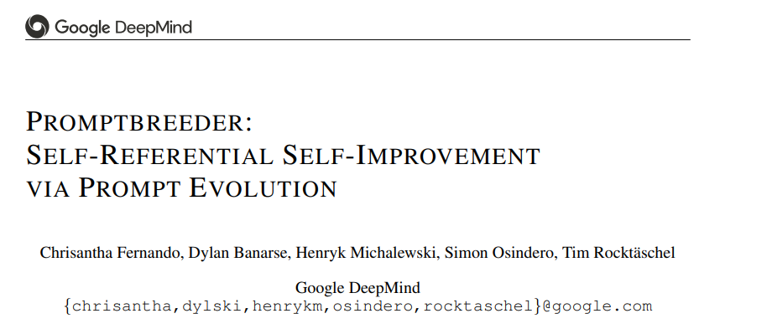

Slide 11
A Diversity maintaining evolutionary algorithm for self-referential self-improvement of prompts for LLMs Automating prompt mutations.
Google introduced Promptbreeder, a prompt evolution system that can automatically explore prompts for a given domain and that is able to find task-prompts that improve an LLM ability to derive answers to questions in that domain. Promptbreeder is general purpose in that the same system is able to adapt to many different domains.
Common prompt techniques, such as Chain-of-Thought Prompting, can significantly enhance Large Language Models' (LLMs') reasoning capabilities across a range of areas. These manually created prompt tactics, meanwhile, are frequently not the best.
Driven by an LLM, Promptbreeder mutates a population of task-prompts, evaluates them for fitness on a training set, and repeats this process over multiple generations to evolve task-prompts.
Most importantly, these task-prompts' mutation is controlled by mutation-prompts, which the LLM creates and refines self-referentially over the course of evolution. In other words, Promptbreeder is enhancing not only the task prompts but also the mutation prompts that further enhance the task prompts.

Slide 12
PROMPTBREEDER: SELF-REFERENTIAL, SELF-IMPROVEMENT VIA PROMPT EVOLUTION
Modern prompt techniques like Chain-of-Thought and Plan-and-Solve Prompting are outperformed by Promptbreeder on widely recognized benchmarks for arithmetic and commonsense reasoning.
Also on a side note promptbreeder is able to evolve intricate task-prompts for the challenging problem of hate speech classification.

Slide 13
The seed set of mutation-prompts .
PROMPTBREEDER (PB) for self-referential self-improvement of LLMs takes a seed set of mutation-prompts (i.e. instructions to modify a task-prompt), thinking-styles (i.e. text descriptions of general cognitive heuristics), and a domain-specific problem description, PB generates variations of the task-prompts and mutation-prompts, exploiting the fact that LLMs can be prompted to act as mutation operators. Based on the fitness of the evolved task-prompts as measured on the training set, we select a subset of evolutionary units consisting of task-prompts and their associated mutation-prompt, to transmit to future generations. Over multiple generations of PB, we observe prompts adapting to the domain at hand. For example, in a mathematical domain, PB evolved the task-prompt
“Show all your working. II. You should use the correct mathematical notation and vocabulary, where appropriate. III. You should write your answer in full sentences and in words. IV. You should use examples to illustrate your points and prove your answers. V. Your workings out should be neat and legible”

Slide 14
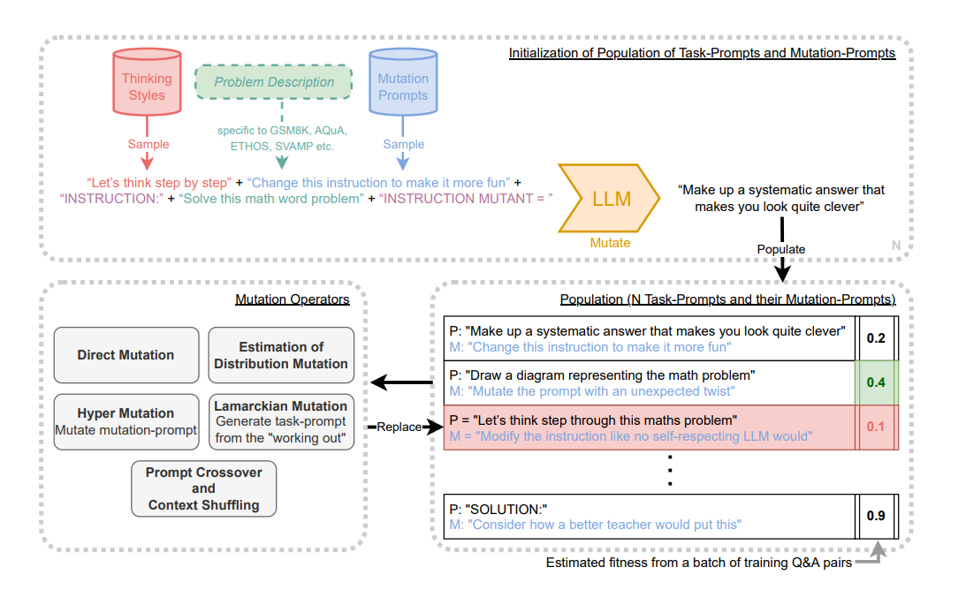

Slide 15
DIRECT MUTATION
The simplest class of mutation operators directly generate a new task-prompt P ′ from either one existing task-prompt P (first-order prompt generation) or from a general prompt that encourages free-form generation of new task-prompts–i.e. not using an existing parent, thus zero-order prompt generation. Zero-order Prompt Generation: We generate a new task-prompt by concatenating the problem description D (e.g. "Solve the math word problem, giving your answer as an arabic numeral") with the prompt "A list of 100 hints:", which invites the LLM to come up with a new hint that could help solve a problem in the given problem domain. We extract the first generated hint as the new task-prompt.
Crucially, this new task-prompt does not depend on any previously found task-prompt. Instead, it is re-generated from the problem description each time. Our rationale for including this zero-order operator is that where prompt evolution diverges, this operator allows us to generate new task-prompts closely related to the original problem description, similar to uniform re-sampling in automated curriculum learning approaches.

Slide 16
First-order Prompt Generation:
We concatenate the mutation-prompt (red), to the parent task-prompt (blue), and pass it to the LLM to produce the mutated task-prompt. For example "Say that instruction again in another way. DON’T use any of the words in the original instruction there’s a good chap. INSTRUCTION: Solve the math word problem, giving your answer as an arabic numeral. INSTRUCTION MUTANT: ".
This procedure is identical to the initialization method, except that a randomly sampled thinking-style string is not used. First-order prompt generation is Promptbreeder’s standard mutation operator, and it is the core of every genetic algorithm—taking one parental genotype (task-prompt) and applying the mutation to it (in this case influenced by the mutation-prompt)

Slide 17
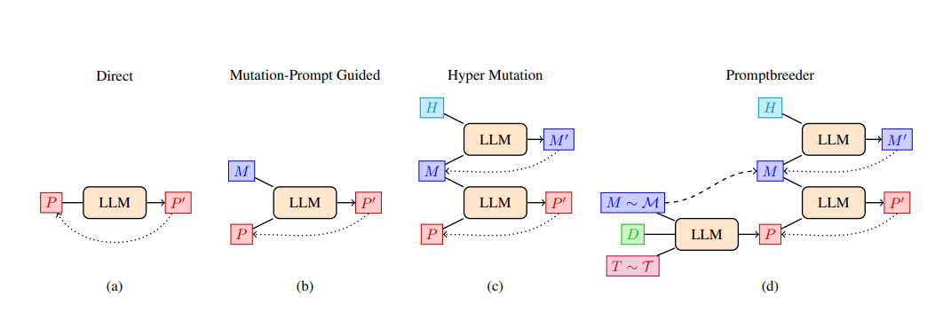

Slide 18
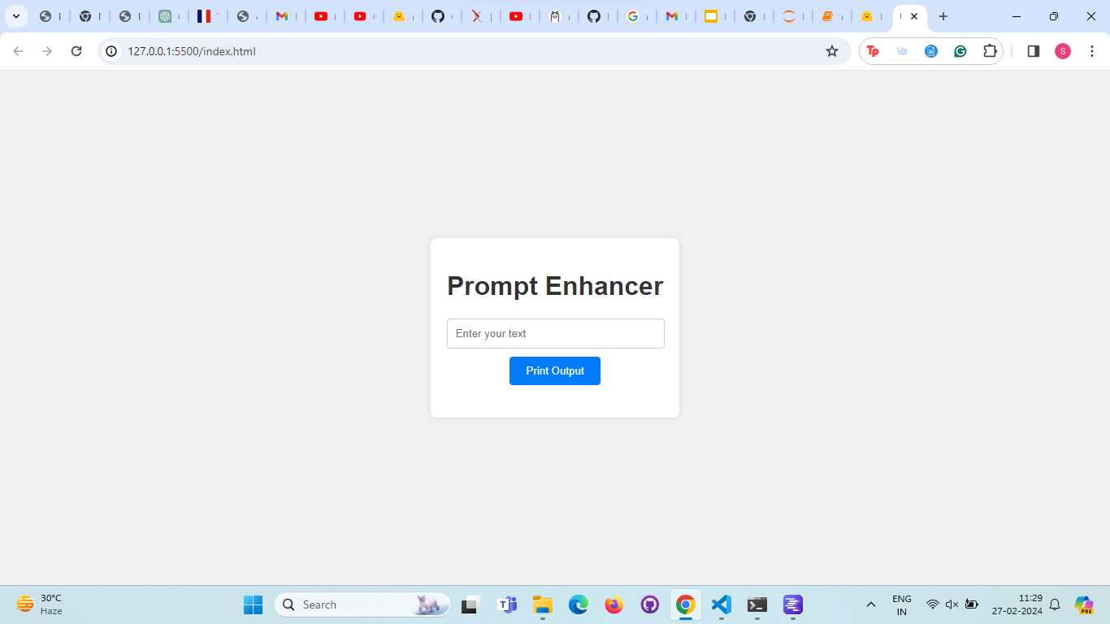

Slide 19
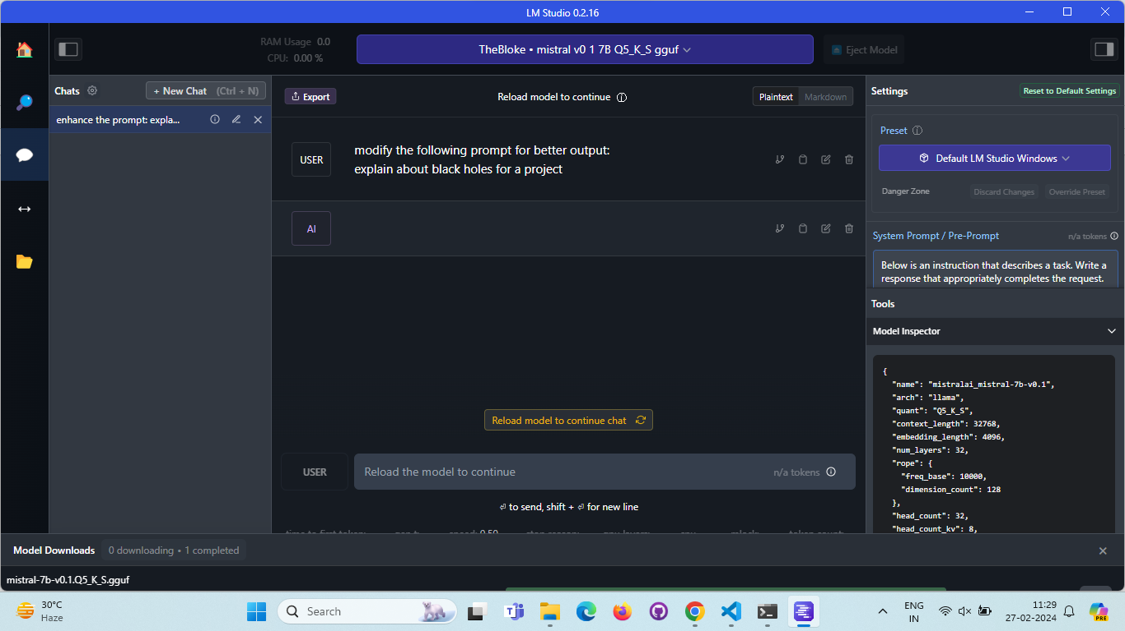
"Provide a comprehensive explanation of black holes suitable for a project, including their formation, characteristics, effects on surrounding space, and significance in astrophysics."

Slide 20
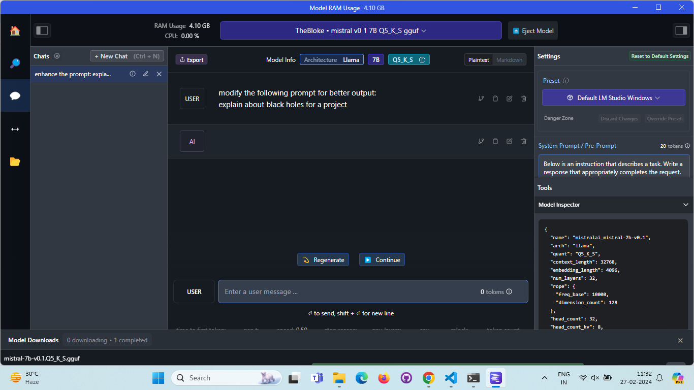

Slide 21
Thank you!

